Slide 1
Design Concepts And Principles
Software Design -- An iterative process transforming requirements into a “blueprint” for constructing the software.

Slide 2
Topics
The Design Process
Design Principles
Design Concepts-Abstraction & Refinement
Software Architecture
Program Partitioning
Coupling and Cohesion

Slide 3
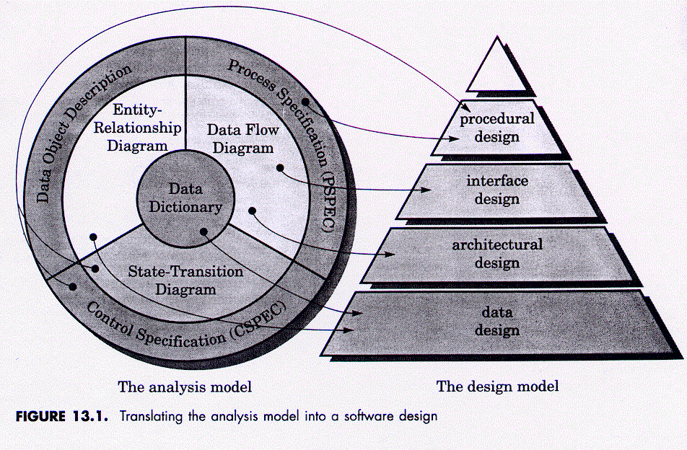
Relation of Analysis to Design

Slide 4
The Design Model
Data Design
  Transforms information domain model into data structures required to implement software
Architectural Design
  Defines relationship among the major structural elements of a program
Procedural Design
Interface Design
Architectural Design
Data Design
The Design Model
Which is mapped from the Analysis model

Slide 5
The Design Model
Interface Design
  Describes how the software communicates with itself, to systems that interact with it and with humans.
Procedural Design
  Transforms structural elements of the architecture into a procedural description of software construction
Procedural Design
Interface Design
Architectural Design
Data Design
The Design Model
Which is mapped from the Analysis model

Slide 6
The Design Process
Mc Glaughlin’s suggestions for good design:
  Design must enable all requirements of the analysis model and implicit needs of the customer to be met
  Design must be readable and an understandable guide for coders, testers and maintainers
  The design should address the data, functional and behavioral domains of implementation

Slide 7
Design Guidelines
A design should exhibit a hierarchical organization
A design should be modular
A design should contain both data and procedural abstractions
Modules should exhibit independent functional characteristics
Interfaces should reduce complexity
A design should be obtained from a repeatable method, driven by analysis

Slide 8
Design Principles
Design Process:
  Iterative steps that enable description of all aspects of the software
Design principles:
  The design process should consider various approaches based on requirements
  The design should be traceable to the requirements analysis model
  The design should not reinvent the wheel -- Reuse!
  Design should mimic the structure in the problem domain

Slide 9
Design Principles
  Design should be uniform and exhibit integrity
  Design should accommodate change
  Design should minimize coupling between modules
  Design should be structured to degrade gently
    It should terminate gracefully and not bomb suddenly
  Design and coding are not interchangeable
  Design should have quality assessment during creation, not afterwards
    This is to reduce development time
  Design should be reviewed to minimize on conceptual errors -- Formal design reviews!

Slide 10
Module
Specification
Specification
Type definitions
Subprogram profiles
Constants
Body
Body
Encapsulated data
Subprogram definitions

Slide 11
type tp is ..
type a is
access tp;
Proc P(z: tp);
func F ret a;
Proc Main;
x: tp;
ax: a;
…
p(x);
ax = F;
...
//
Y: tp;
Proc P is
…
end P;
func F is
… end F;
Caution
with
pointers!!
//

Slide 12
Module A specification
Module B body
type shuttle is record
x: float; -- wrt to coord sys
y: float; -- wrt to coord sys
z: float: -- wrt to coord sys
roll: float;
pitch: float;
yaw: float;
end record;
function get return shuttle;
s: A.shuttle;
x_coord: float;
…
s := A.get;
display(s);
…
x_coord := s.x;
...
Body A

Slide 13
Module A specification
Module B body
type shuttle is record
x: float; -- latitude
y: float; -- longitude
z: float: -- elevation
roll: float;
pitch: float;
yaw: float;
end record;
function get return shuttle;
s: A.shuttle;
x_coord: float;
…
s := A.get;
display(s);
…
x_coord := s.x;
...
Body A

Slide 14
Module A specification
type shuttle is private;
function get return shuttle;
function get_lat(s) return float;
function get_x(s) return float;
function get_long(s) return float;
…
procedure display(s:shuttle);
…
private
type shuttle is record
x,y,z: float;
roll, pitch,yaw: float;
end record;
Module B body
s: A.shuttle;
x_coord: float;
…
s := A.get;
A.display(s);
…
x_coord := A.get_x(s);
...

Slide 15
Design Concepts-Abstraction
Wasserman: “Abstraction permits one to concentrate on a problem at some level of abstraction without regard to low level details”
Data Abstraction
  This is a named collection of data that describes a data object
Procedural Abstraction
  Instructions are given in a named sequence
  Each instruction has a limited function

Slide 16
Refinement
Refinement is a process where one or several instructions of the program are decomposed into more detailed instructions.
Stepwise refinement is a top down strategy
  Basic architecture is developed iteratively
  Step wise hierarchy is developed
Forces a designer to develop low level details as the design progresses
  Design decisions at each stage

Slide 17
Modularity
In this concept, software is divided into separately named and addressable components called modules
Follows “divide and conquer” concept, a complex problem is broken down into several manageable pieces
Let p₁ and p₂ be two program parts, and E the effort to solve the problem. Then,
E(p₁+p₂) > E(p₁)+E(p₂)
A need to divide software into optimal sized modules

Slide 18
Module A specification
type shuttle is private;
function get return shuttle;
function get_lat(s) return float;
function get_x(s) return float;
function get_long(s) return float;
…
procedure display(s:shuttle);
…
private
type shuttle is record
x,y,z: float;
roll, pitch,yaw: float;
end record;
Module B body
s: A.shuttle;
x_coord: float;
…
s := A.get;
A.display(s);
…
x_coord := A.get_x(s);
...

Slide 19
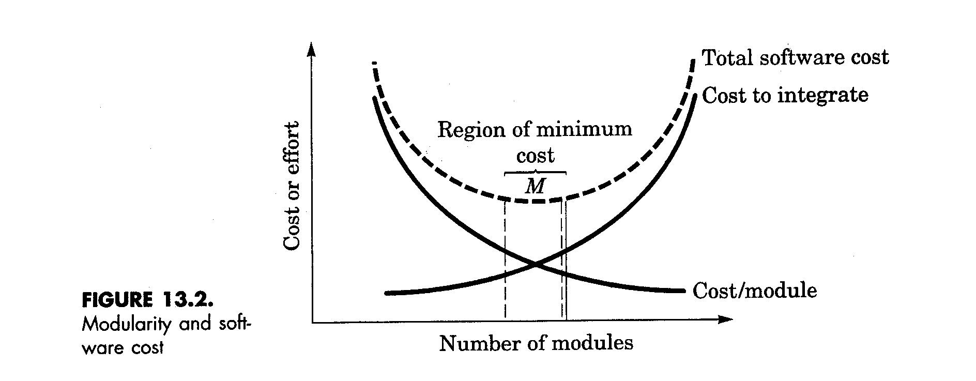
Modularity & Software Cost

Slide 20
Modularity
Objectives of modularity in a design method
Modular Decomposability
  Provide a systematic mechanism to decompose a problem into sub problems
Modular Composability
  Enable reuse of existing components
Modular Understandability
  Can the module be understood as a stand alone unit? Then it is easier to understand and change.

Slide 21
Modularity
Modular Continuity
  If small changes to the system requirements result in changes to individual modules, rather than system-wide changes, the impact of the side effects is reduced
Modular Protection
  If there is an error in the module, then those errors are localized and not spread to other modules

Slide 22
Software Architecture
Desired properties of an architectural design
Structural Properties
  This defines the components of a system and the manner in which these interact with one another.
Extra Functional Properties
  This addresses how the design architecture achieves requirements for performance, reliability and security
Families of Related Systems
  The ability to reuse architectural building blocks
Notes:
Note the importance of the performance aspect of things. State example of Ada compilers and time.

Slide 23
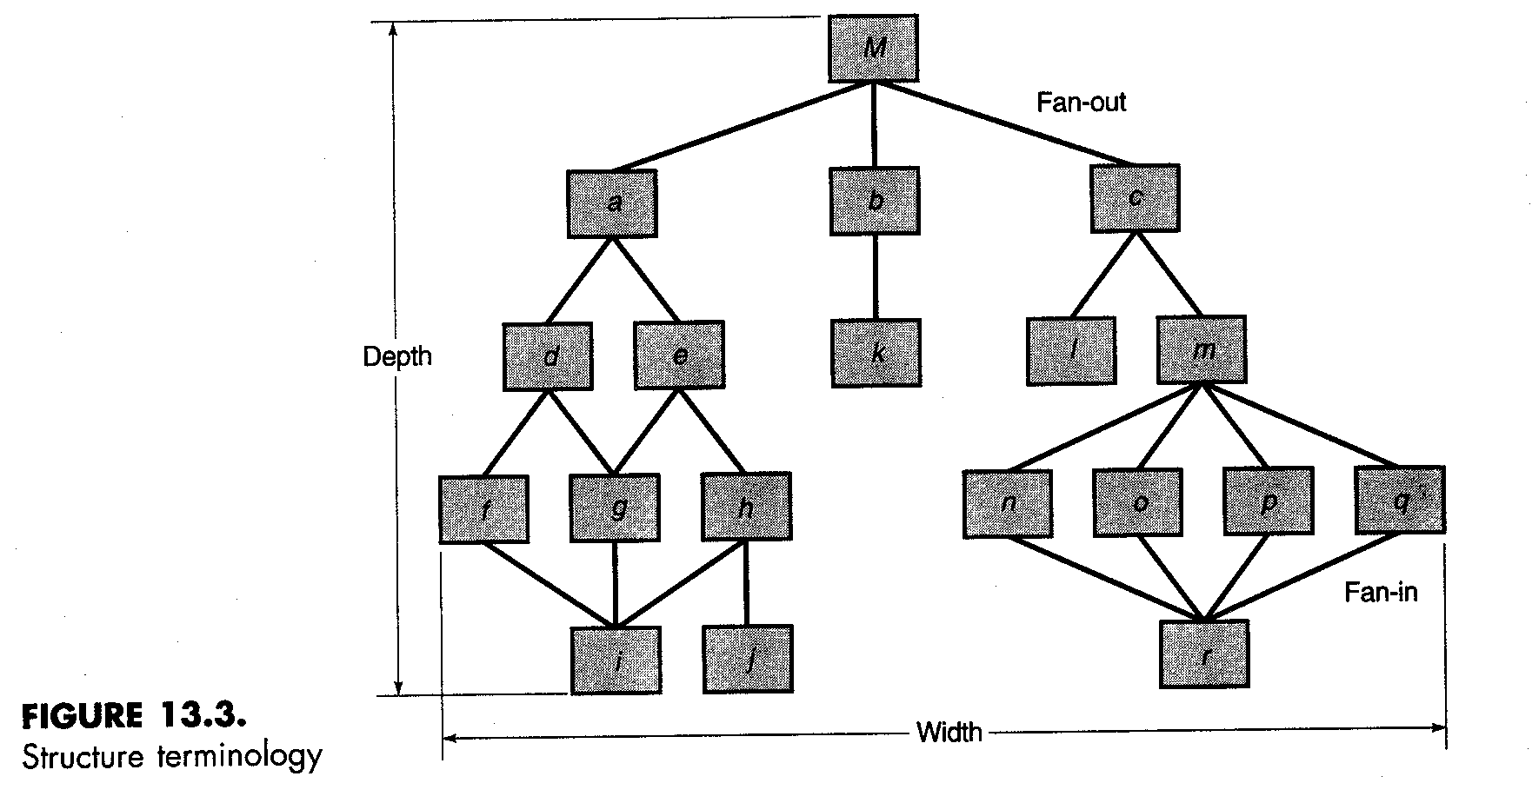
Structural Diagrams

Slide 24
Kinds of Models
Terminology
  Structural models
    Organized collection of components
  Framework models
    Abstract to repeatable architectural patterns
  Dynamic models
    Behavioral (dynamic) aspects of structure
  Process models
    Business or technical process to be built
  Functional models
    Functional hierarchy of the system

Slide 25
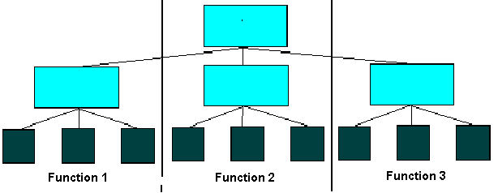
Program Structure Partitioning
Horizontal Partitioning
  Easier to test
  Easier to maintain (questionable)
  Propagation of fewer side effects (questionable)
  Easier to add new features
F1 (Ex: Input) F2 (Process) F3(Output)

Slide 26
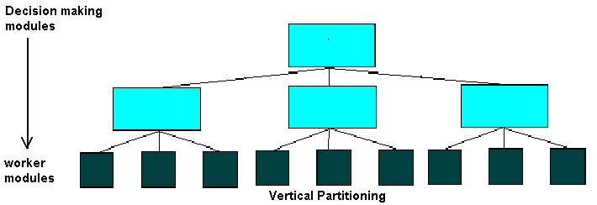
Program Structure Partitioning
Vertical Partitioning
  Control and work modules are distributed top down
  Top level modules perform control functions
  Lower modules perform computations
    Less susceptible to side effects
    Also very maintainable

Slide 27
Information Hiding
Modules are characterized by design decisions that are hidden from others
Modules communicate only through well defined interfaces
Enforce access constraints to local entities and those visible through interfaces
Very important for accommodating change and reducing coupling
Notes:
Choice of language helps a lot here.

Slide 28
Module A specification
type shuttle is private;
function get return shuttle;
function get_lat(s) return float;
function get_x(s) return float;
function get_long(s) return float;
…
procedure display(s:shuttle);
…
private
type shuttle is record
x,y,z: float;
roll, pitch,yaw: float;
end record;
Module B body
s: A.shuttle;
x_coord: float;
…
s := A.get;
A.display(s);
…
x_coord := A.get_x(s);
...

Slide 29
Functional Independence
Critical in dividing system into independently implementable parts
Measured by two qualitative criteria
  Cohesion
    Relative functional strength of a module
  Coupling
    Relative interdependence among modules

Slide 30
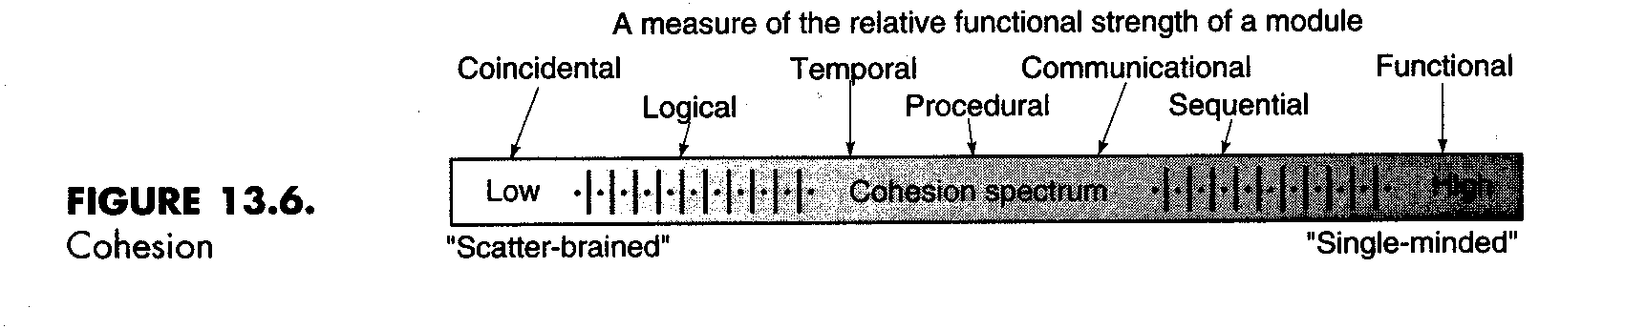
Modular Design -- Cohesion
A cohesive module performs a single task
Different levels of cohesion
  Coincidental, logical, temporal, procedural, communications, sequential, functional

Slide 31
Modular Design -- Cohesion
Coincidental Cohesion
  Occurs when modules are grouped together for no reason at all
Logical Cohesion
  Modules have a logical cohesion, but no actual connection in data and control
Temporal Cohesion
  Modules are bound together because they must be used at approximately the same time

Slide 32
Modular Design -- Cohesion
Communication Cohesion
  Modules grouped together because they access the same Input/Output devices
Sequential Cohesion
  Elements in a module are linked together by the necessity to be activated in a particular order
Functional Cohesion
  All elements of a module relate to the performance of a single function
Notes:
Coupling is the relationship between two modules

Slide 33
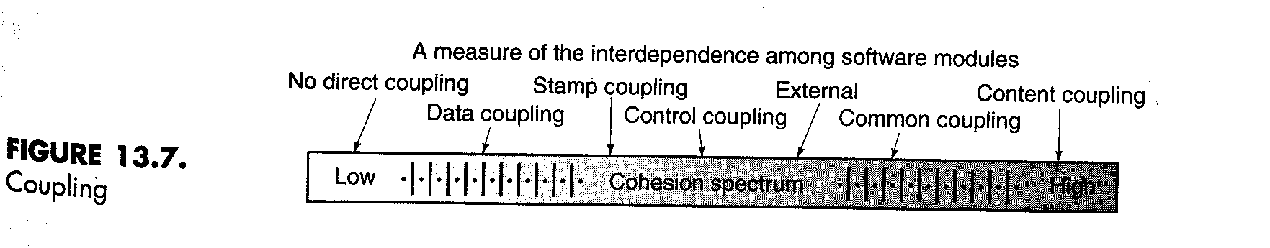
Modular Design -- Coupling
Coupling describes the interconnection among modules
Data coupling
  Occurs when one module passes local data values to another as parameters
Stamp coupling
  Occurs when part of a data structure is passed to another module as a parameter

Slide 34
Modular Design -- Coupling
Control Coupling
  Occurs when control parameters are passed between modules
Common Coupling
  Occurs when multiple modules access common data areas such as Fortran Common or C extern
Content Coupling
  Occurs when a module data in another module
Subclass Coupling
  The coupling that a class has with its parent class

Slide 35
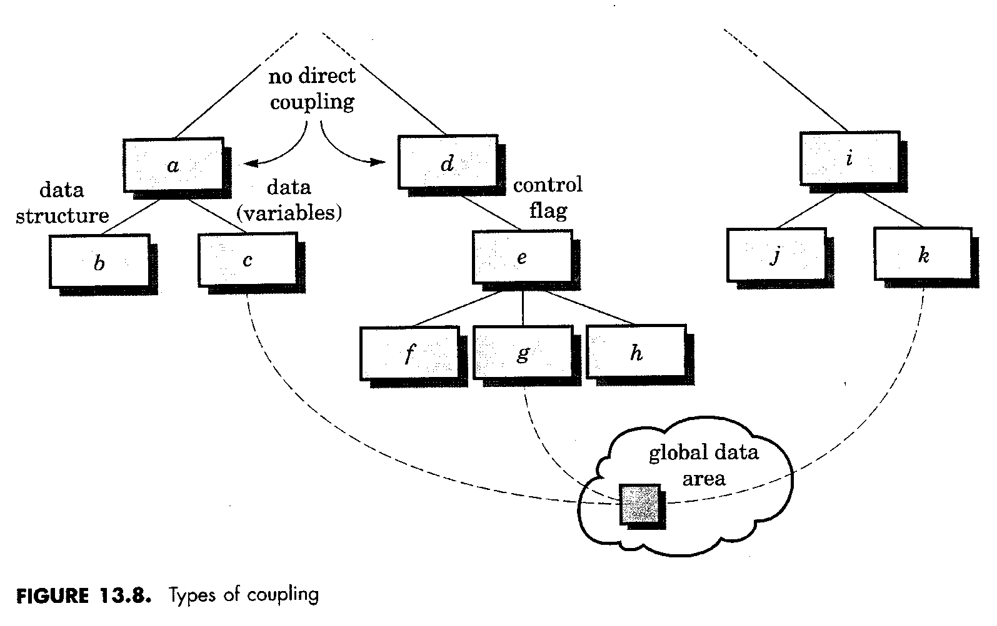
Examples of Coupling

Slide 36
Design Heuristics
Evaluate 1st iteration to reduce coupling & improve cohesion
Minimize structures with high fan-out; strive for depth
Keep scope of effect of a module within scope of control of that module
Evaluate interfaces to reduce complexity and improve consistency

Slide 37
Design Heuristics
Define modules with predictable function & avoid being overly restrictive
  Avoid static memory between calls where possible
Strive for controlled entry -- no jumps into the middle of things
Package software based on design constraints and portability requirements

Slide 38
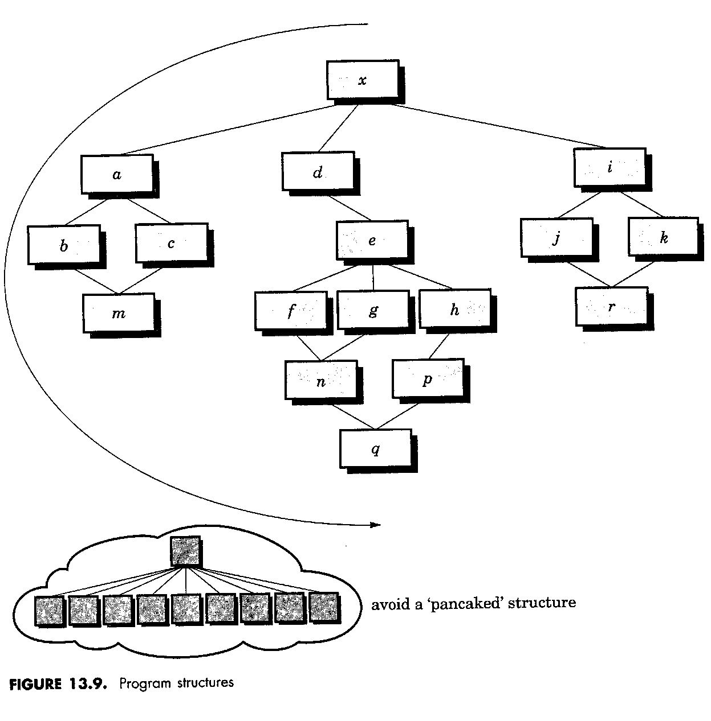
Program Structure

Slide 39
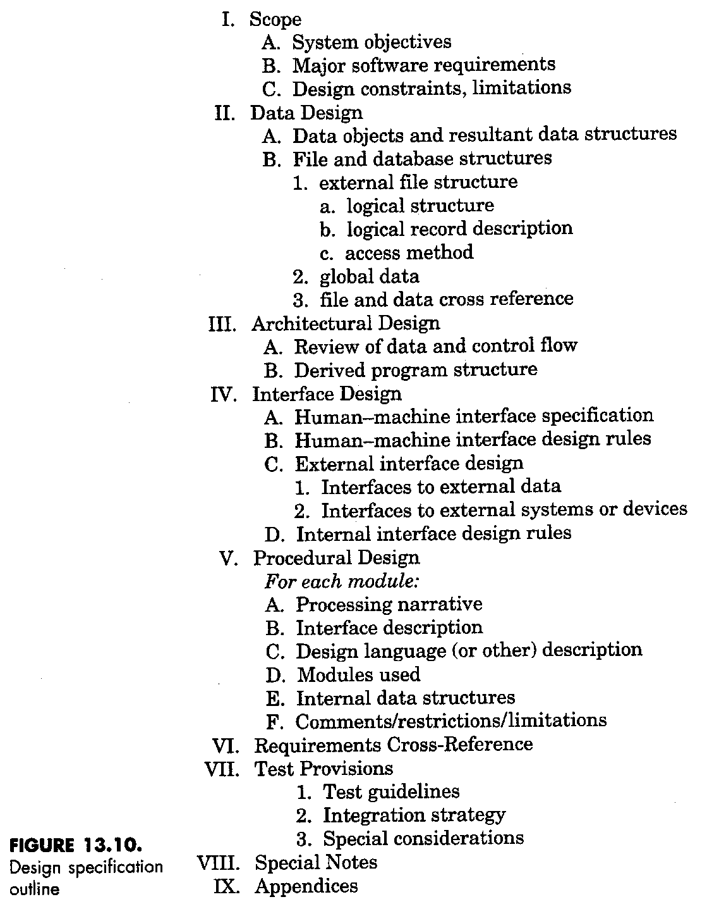
Documentation

Slide 40
Summary
Design is the core of software engineering
Design concepts provide the basic criteria for design quality
Modularity, abstraction and refinement enable design simplification
A design document is an essential part of the process

